Slide 1

Patient Travel and Treatment Center Selection for New Gene Therapies in Brazil
Sarah Wertheimer, MIT CTL
July 2024

Slide 2
Project Overview

Slide 3
Project Blurb
Optimizing Gene Therapy Supply Chains and Patient Travel
How can optimization modeling shed light on how patient travel considerations could be incorporated into gene therapy treatment center selection?
After exploring various steps along the gene therapy supply chain and their connections to patient access, we’ve decided to focus on gene therapy treatment center selection and patient travel. Choosing how many and which treatment centers at which to offer a gene therapy to patients is a crucial decision which impacts how far the treatment has to be transported and how far patients have to travel to receive treatment. Many gene therapies are for patients with severe diseases that make it difficult to travel. On the other hand, cold chain requirements give gene therapies short transport windows and expensive transportation costs. Using optimization modeling paired with local input we hope to explore how to best balance these considerations as the supply chain is being designed. Expected outputs of this work are a case study on a product in Brazil, a model that could be used for other cases, and a thesis.
Sarah Wertheimer, MIT (wertheis@mit.edu, sarah.wertheimer@roche.com)

Slide 4
Project Timeline
2023
First year
Scoping
Background research
Initial modeling
Talking to global teams
Winter 2024
Trip to Brazil
Modeling iterations
Trip to São Paulo
Spring 2024
Finalizing and showcasing model
Feedback from Brazil team Interactive workshop
Summer 2024
Final handover
Final deliverables
Thesis
Notes:
Patient travel product travel discussion in on site Innovation Workshop helped inspire this project

Slide 5
Scope

Slide 6
Background on Brazil
Statistics:
3.3 million mi² / 8.5 million km² area
26 states, 1 federal district
215.3 million people
Health system:
Sistema Único de Saúde (SUS)
Government-run, public health system
Free, universal care
Product in pre-approval distribution stage, working towards approval
Currency:
Brazilian Real (BRL)
1 BRL ≅ 0.2 USD
5 BRL ≅ 1 USD

Slide 7
Focus on treatment infusion locations
Referral Center
(Diagnosis, eligibility, & follow-up)
Treatment Center
(Infusion)
Requires specialized physician
Does not require center willingness to handle high value product
Does not require gene therapy product
Requires specialized physician with extra training
Requires center willingness to handle high value product
Requires gene therapy product
Focus of my project

Slide 8
Focus on TC-selection-dependent costs
1. Country entry cost
Health authority approval process
Country health system incorporation process
2. Patient cost (cost per patient treated)
Fixed cost of treatment
Fixed cost of administration
Fixed cost of cold chain treatment transportation into country
3. Treatment center fixed cost (cost per treatment center)
Site contracting and physician registration
Site training on operations process
Database maintenance IT cost
Admin helpline burden
4. Last-mile variable treatment transport cost (proportional to distances from country entry point to treatment centers)
Additional cold chain transport mileage
Incremental cold chain duration
5. Patient travel variable cost (proportional to distances from patients to treatment centers)
Additional cost to further travel
Additional burden to further travel beyond ‘travel cost’, esp. with potential for multiple required trips
Not dependent on TC selection
Focus of my project
Notes:
Taken from Meeting Notes with Sergi, Dec. 21, 2023

Slide 9
Model

Slide 10
Model: Balancing three factors
Treatment center cost
(cost per center)
The higher priority this is, the smaller the number of centers.
The lower priority this is, the larger the number of centers.
Last-mile treatment transport cost
(cost per km of in-country treatment transportation)
The higher priority this is, the closer treatment centers will be to the treatment start points.
The lower priority this is, the farther treatment centers will be to the treatment start points.
Patient travel cost
(cost per km of patient travel)
The higher priority this is, the closer treatment centers will be to patients.
The lower priority this is, the farther treatment centers will be to patients.

Slide 11
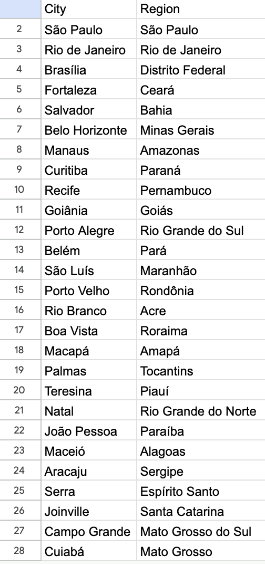
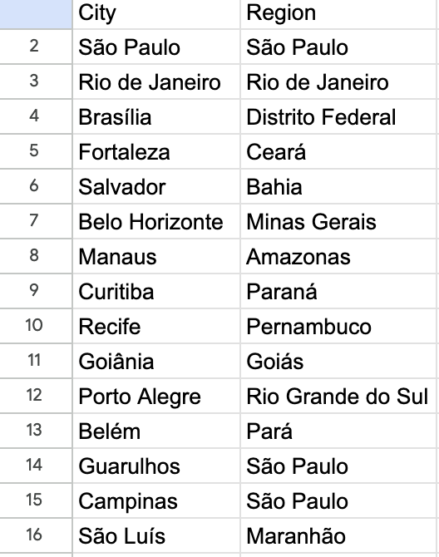
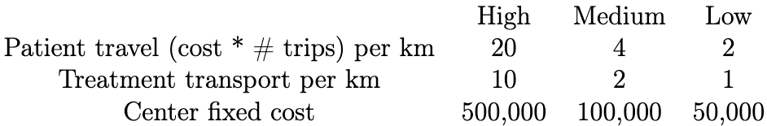
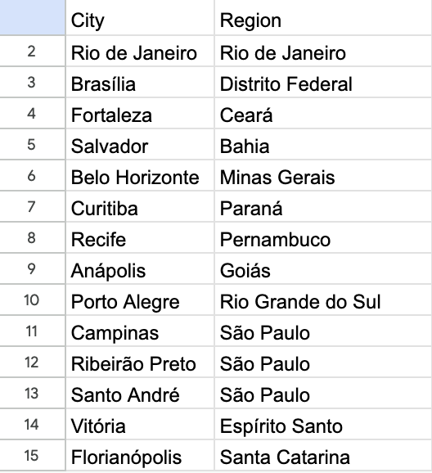
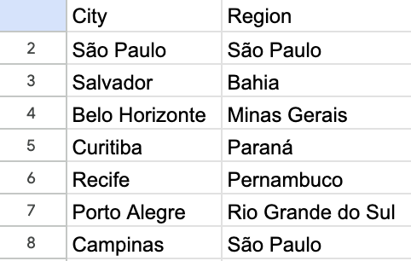
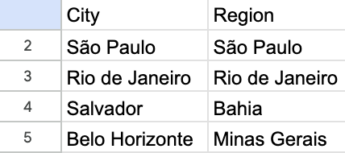
Data Inputs
Biggest City in Each State
15 Most Populous Cities
Parameter Costs
RD Reference Center Cities
Shapefiles (map boundaries and coordinates)
geobr package
Approach definitions
Ex: Centralize
Center cost: HIGH
Patient travel: LOW
Treatment transport: MEDIUM
Options: 15 biggest cities
Previous GT Cities
4 “Main” Cities
Treatment start points
GRU GYN
Center candidates
Estimated patient populations
Census data & prevalence data

Slide 12
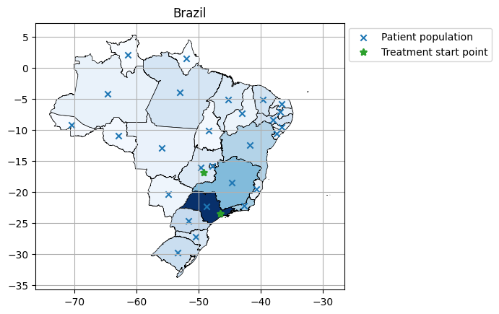
Fixed Model Parameters
Number of patients
Population distribution
Treatment start points (where the gene therapy treatment enters the country)
582 patients, distributed proportionally to the population
Treatment enters the country at GRU and GYN airports

Slide 13
Baseline Costs
Treatment center cost
(cost per center)
Based on the line-item breakdown of distribution costs from an international distributor for the pre-approval stage in Brazil, we came up with a lower bound of 8,500 EUR for the cost per treatment center location, which is approximately 50,000 BRL
Last-mile treatment transport cost
(cost per km of in-country treatment transportation)
Based on a driving-distance calculator, using the trip from Cuiabá, MT to Goiâna, GO as a representative trip, we estimated a lower bound of 0.2 USD/km, which is approximately 1 BRL/km
Patient travel cost
(cost per km of patient travel)
Assuming patients will need to travel both to and from treatment center locations, we therefore estimated a lower bound of 0.4 USD/km of distance (=2 * 0.2 USD/km), which is approximately 2 BRL/km
Since these lower bounds were significant underestimates, they were doubled to come up with our MEDIUM (1x) reference costs used to make model estimations

Slide 14
Menu of Input Options
Candidate locations
Locations with previous GT experience | Government RD reference center locations | Biggest cities in each state
Patient travel cost priority level
HIGH (5x) | MEDIUM (1x) | LOW (0.5x)
Treatment transportation cost priority level
HIGH (5x) | MEDIUM (1x) | LOW (0.5x)
Center fixed cost priority level
HIGH (5x) | MEDIUM (1x) | LOW (0.5x)
Candidate locations
Priority levels for:
Patient travel
Treatment transportation
Center costs

Slide 15
Results
Five defined approaches
Interactive workshop results

Slide 16
Five Approaches to TC-Selection

Slide 17
Approach descriptions
Centralize
Minimize complexity by centralizing and limiting the number of centers. Not concerned much with patient travel.
Candidate locations: 15 Biggest cities
Priorities:
Center: HIGH, Transport: MEDIUM, Patient: LOW
Copy Prev. Therapy
Only consider centers which already provide other gene therapies. The treatment center cost priority is low, as the centers are mostly setup.
Candidate locations: Cities with previous gene therapy offerings
Priorities: Center: LOW, Transport: MEDIUM, Patient: MEDIUM
Early Physicians
Allow influential physicians in the biggest states to defacto choose by bringing the treatment to their centers.
Candidate locations: 4 "main" cities
Priorities:
Center: MEDIUM, Transport: MEDIUM, Patient: MEDIUM
Government
The government decides to spread treatment centers among existing rare disease reference centers. Not interested in transportation costs as those likely born by the company.
Candidate locations: Cities with rare disease reference centers
Priorities:
Center: MEDIUM, Transport: LOW,
Patient: HIGH
Patient Travel Focus
Strong focus on patient travel.
Candidate locations:
Biggest city in each state
Priorities:
Center: LOW, Transport: LOW, Patient: HIGH

Slide 18
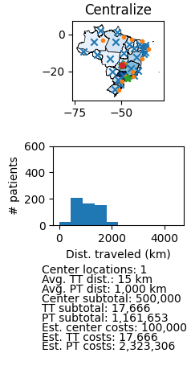
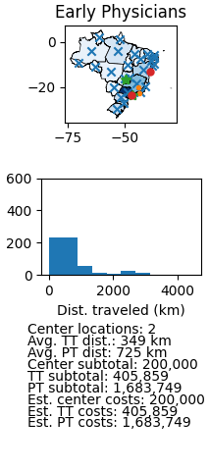
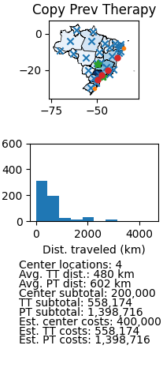
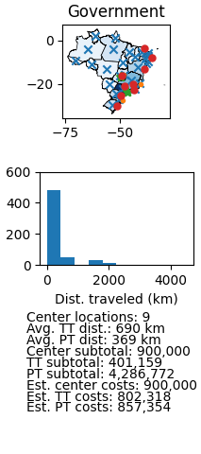
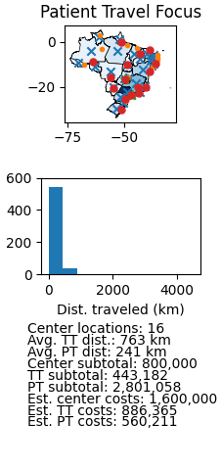
State-level patient populations

Slide 19
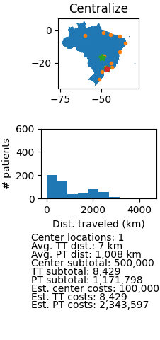
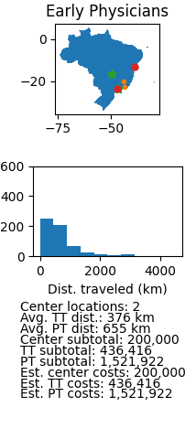
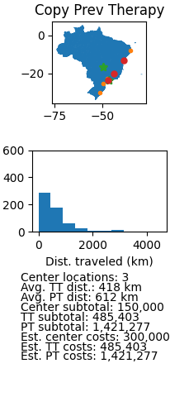
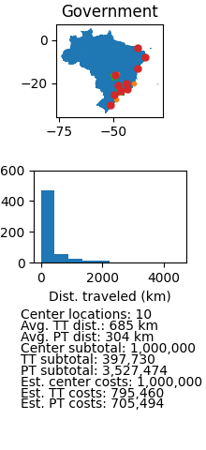
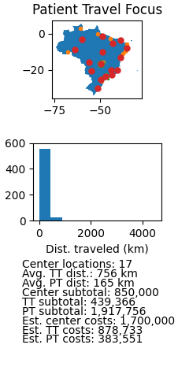
Municipality-level patient populations

Slide 20
Interactive Workshop Results

Slide 21
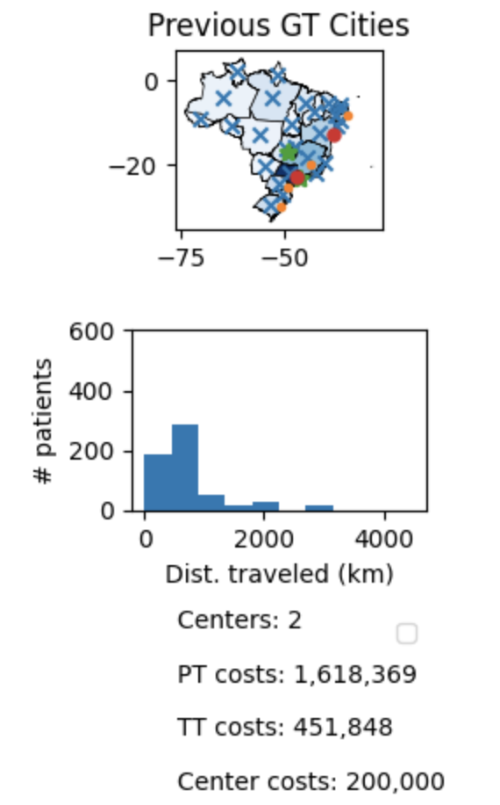
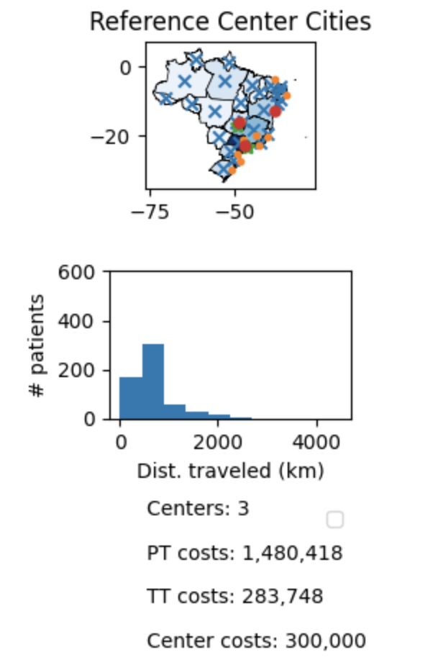
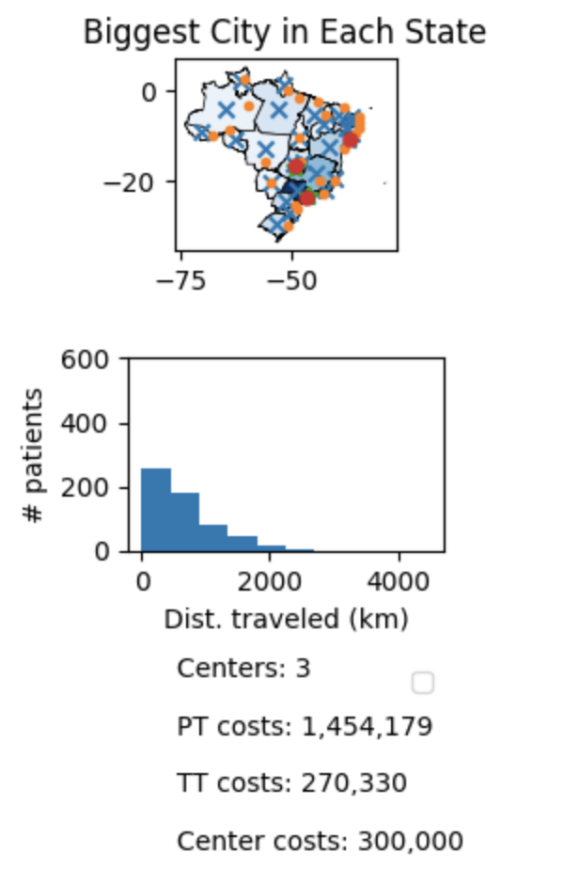
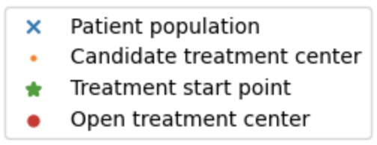
All Medium Priority (pre-workshop)
Patient Advocacy Group
Government
Pharma

Slide 22
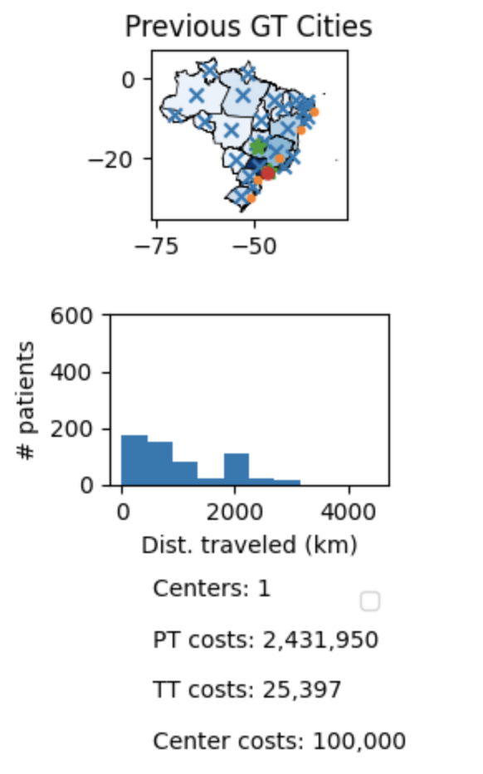
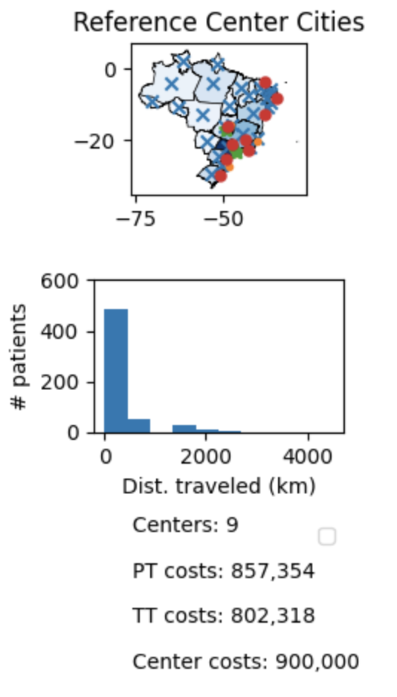
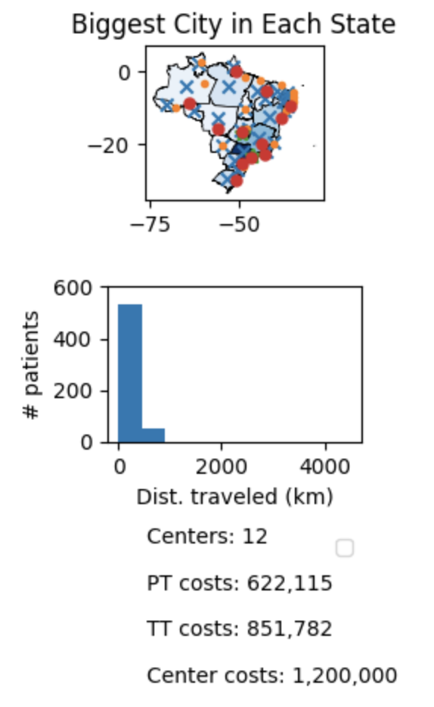
High Top Priority, Others Medium (pre-workshop)
HIGH treatment transport
HIGH patient travel
HIGH patient travel
Patient Advocacy Group
Government
Pharma

Slide 23
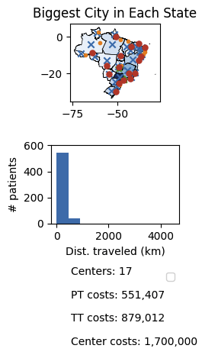
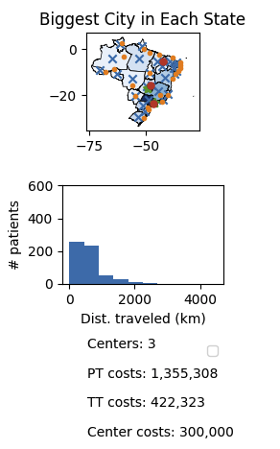
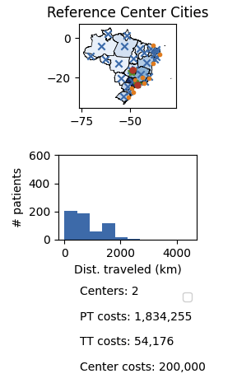
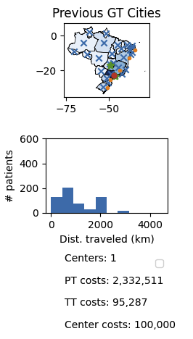
PAG preferences
Middle ground exploration
Government preferences
Pharma preferences
Center: LOW
Patient: HIGH
Transport: MEDIUM
Center: MEDIUM
Patient: MEDIUM
Transport: LOW
Center: LOW
Patient: LOW
Transport: MEDIUM
Center: HIGH
Patient: MEDIUM
Transport: MEDIUM
Workshop exploration and stakeholder roleplay
Notes:
Applied to Brazil,

Slide 24
Appendix: Reference Maps

Slide 25
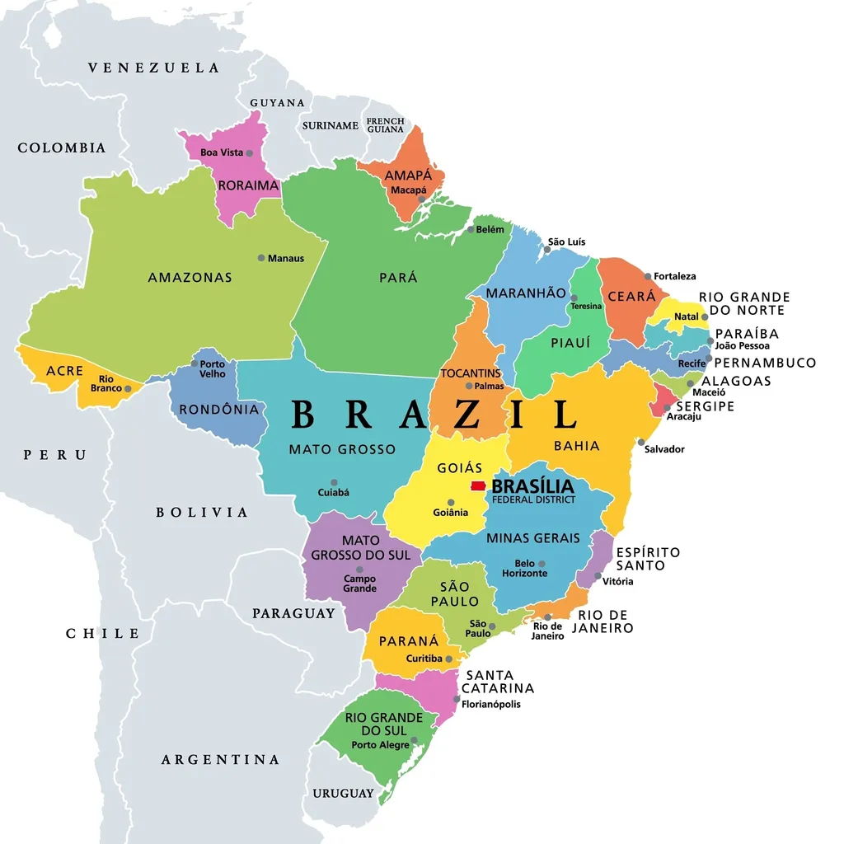
https://www.mappr.co/counties/brazil-states-map/
Treatment Start Points and Patient Populations

Slide 26
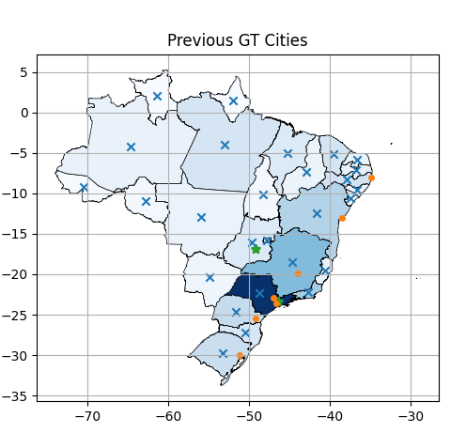
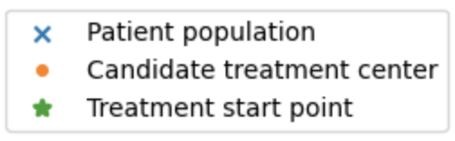
https://www.mappr.co/counties/brazil-states-map/
Previous Gene Therapy Treatment Center Cities

Slide 27
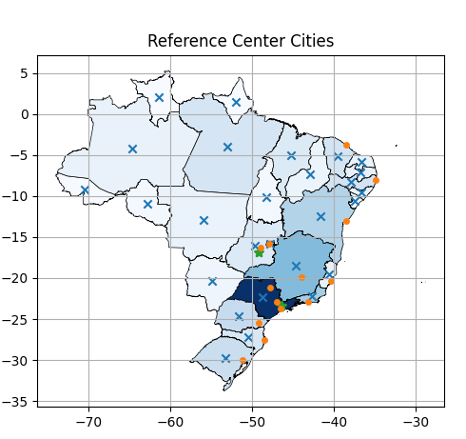
https://www.mappr.co/counties/brazil-states-map/
Reference Center Cities

Slide 28
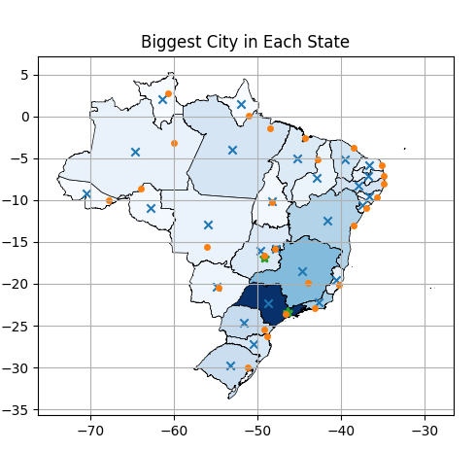
https://www.mappr.co/counties/brazil-states-map/
Biggest City in Each State

